Slide 1
CONTINOUS INTEGRATION
PRESENTED BY
SANA S NAVAS

Slide 2
WHAT IS CONTINOUS INTEGRATION ?
Definition: Continuous Integration (CI) is a software development practice where developers frequently integrate code into a shared repository.
Goal: Detect and address integration issues early.
KEY CHARACTERISTICS
Frequent commits to version control.
Automated build and test processes.
Immediate feedback on code quality.

Slide 3
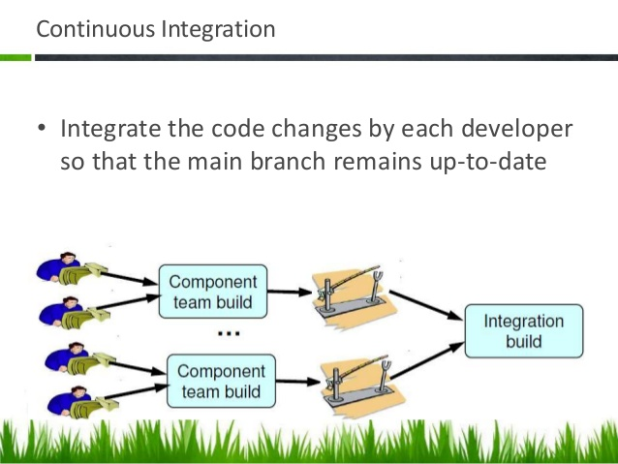

Slide 4
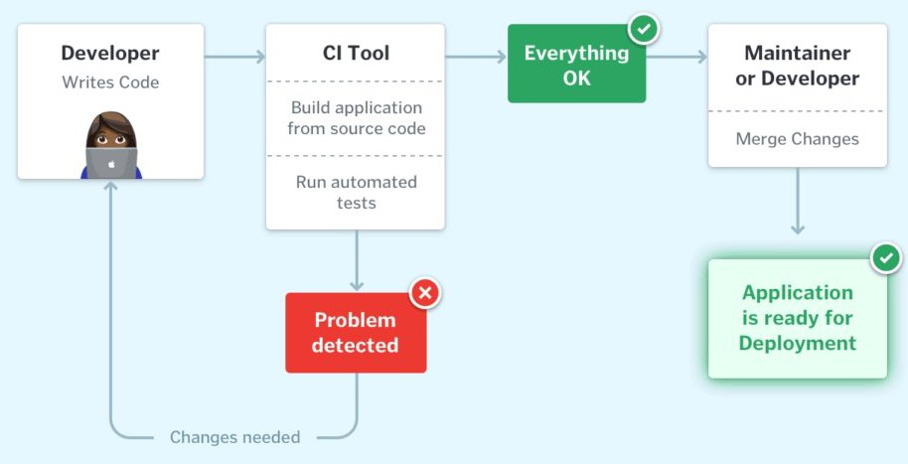

Slide 5
Importance of Continuous Integration
Catches bugs early.
Reduces integration issues.
Encourages team collaboration.
Ensures a stable codebase.

Slide 6
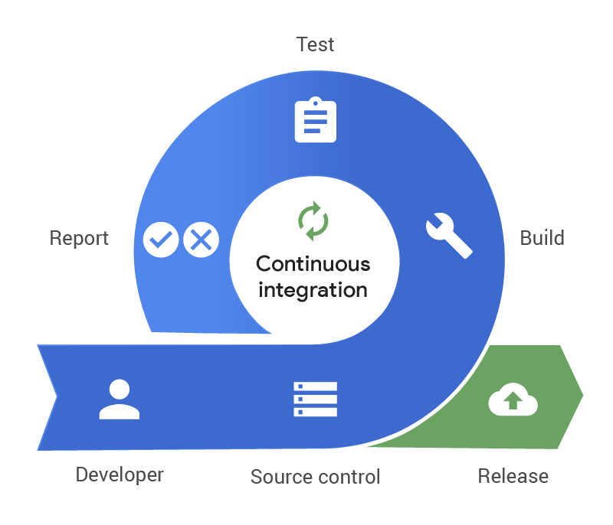

Slide 7
Prerequisites for Continuous Integration
Version Control System (VCS): Tools like Git to manage source code.
Automated Build Scripts: Command-line scripts to build, test, and deploy software.
Commit Culture: Developers must commit small, incremental changes frequently.
CI Tools: Tools like Jenkins, GitHub Actions, or CircleCI.
Team Discipline: Agreement to follow CI practices.

Slide 8
ESSENTIAL CI PRACTICES
Automated Builds:
Start builds from the command line.
Ensure consistency across environments.
Frequent Commits:
Check-in small changes frequently.
Avoid long-lived feature branches.
Automated Tests:
Include unit, integration, and functional tests in the CI pipeline.
Immediate Feedback:
Notify the team of build and test results promptly.
Fix Broken Builds Immediately:
Treat broken builds as the highest priority.

Slide 9
A Basic CI Workflow
Check if the Build is Running: Wait for it to finish.
Sync Your Local Code: Update from the version control repository.
Run Local Tests: Verify your changes locally.
Commit Changes: Push your updates to the repository.
Wait for CI Results: Validate the build on the CI server.
Fix Issues Promptly: Address any failed tests immediately.

Slide 10
CI is a practice, not a tool.
It requires discipline from the development team.
The objective of CI is to ensure that software is working continuously.

Slide 11
ESSENTIAL PRACTICES IN CI

Slide 12
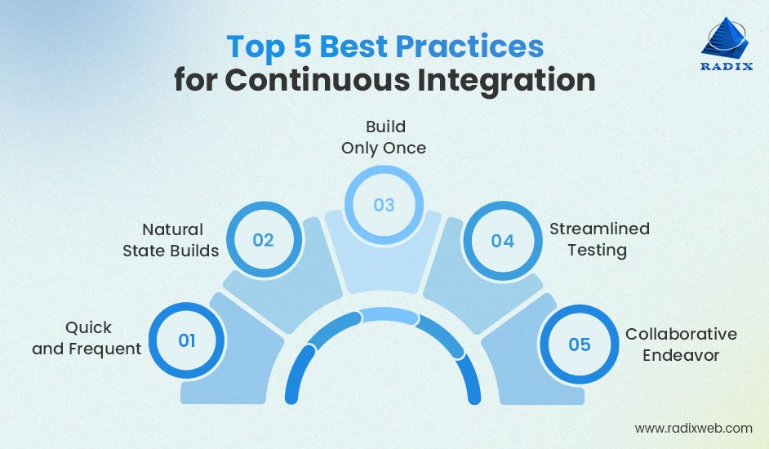

Slide 13
Don’t Check In on a Broken Build
If the build breaks, the developers responsible must fix it immediately.
Delaying the fix leads to longer downtimes and a broken build.
Always Run All Commit Tests Locally Before Committing
Running commit tests locally acts as a sanity check.
It helps identify problems caused by code merged by others before committing.
Prevents breaking the build due to missing files or other changes.

Slide 14
Wait for Commit Tests to Pass Before Moving On
Wait for the CI tests to pass before proceeding.
If the build fails, address the issue immediately to maintain smooth progress.
Never Go Home on a Broken Build
Don’t leave with a broken build.
Always commit early enough to address any issues before leaving.
Avoid leaving the build in a broken state for others to deal with.

Slide 15
Always Be Prepared to Revert to the Previous Revision
If you can’t fix the problem quickly, revert to the previous working revision.
Ensure quick recovery and don’t let issues linger.
Adopt a mindset similar to pilots being prepared for emergency situations.
Time-Box Fixing Before Reverting
Set a team rule to fix the build within 10 minutes.
If unable to fix the issue, revert to the previous revision to avoid delays.

Slide 16
Don’t Comment Out Failing Tests
Commenting out failing tests is a last resort.
It is better to address the failing tests immediately, rather than bypassing them.
Occasionally, comment out tests only for urgent work or customer discussions.
Take Responsibility for All Breakages
If your changes break the build, you are responsible for fixing all failed tests.
Ensure the software remains functional for all team members.
Collaboration and Access to the Codebase
For effective CI, ensure all team members have access to the full codebase.
If access restrictions are unavoidable, collaborate well with those who have necessary access.

Slide 17
CONCLUSION
Continuous Integration is crucial for maintaining software quality.
Follow best practices to ensure a smooth and efficient CI process.
Discipline, responsibility, and collaboration are key to successful CI.

